Slide 1

Review of Statistical Concepts
Financial Modeling

Slide 2
Statistics concepts (Textbook Chapter 3)
Descriptive statistics
How to summarize data
How to describe important aspects of large data set
Inferential statistics
Making forecasts, estimates or judgments about a large group from the smaller group actually observed

Slide 3
Fundamental elements of statistics
Population – the entire set of units we are interested in learning about
Example : all companies that are publicly traded in US
Experimental Unit – an object of interest
Example: a publicly traded company in SP500
Sample – subset of population
Example: public companies listed in SP500
Variable – a characteristic of an individual experimental unit: eg, Earnings Per Share (EPS)
Statistical inference – generalization about a population based on sample data
Example: The average EPS of SP500 was 23.28 in June 2016 (based on sample of SP500 companies)

Slide 4
Issues in descriptive and inferential statistics
Population or sample of interest
Variables of interest
Numerical summary tools (charts, graphs and tables)
Identification of patterns in data
Inference about population based on sample data
A measure of reliability for the inference

Slide 5
Types of data by nature
Quantitative data
Ratio data (bank assets, firm inventory)
Interval data (temperature)
Qualitative data
Measured by classification only
Non-numerical in nature
Ordinal data (best to worst ranking, age categories)
Nominal data (political affiliation, industry classification, ethnic/cultural groups)

Slide 6
Analyzing quantitative and qualitative data
Different statistical techniques used for quantitative and qualitative data
Qualitative and Quantitative data can be used together in some techniques
Quantitative data can be transformed into qualitative data through category creation
Group people according to their income
Qualitative data cannot be meaningfully transformed into quantitative data

Slide 7
Methods of describing data
Describing data using charts and graphs

Slide 8
Describing qualitative data
Qualitative data are nonnumeric in nature
Best described by using Classes
Descriptive measures
Class frequency=number of data points in a class
Class relative frequency=class frequency/ total number of data points in dataset
Class percentage =class relative frequency * 100

Slide 9
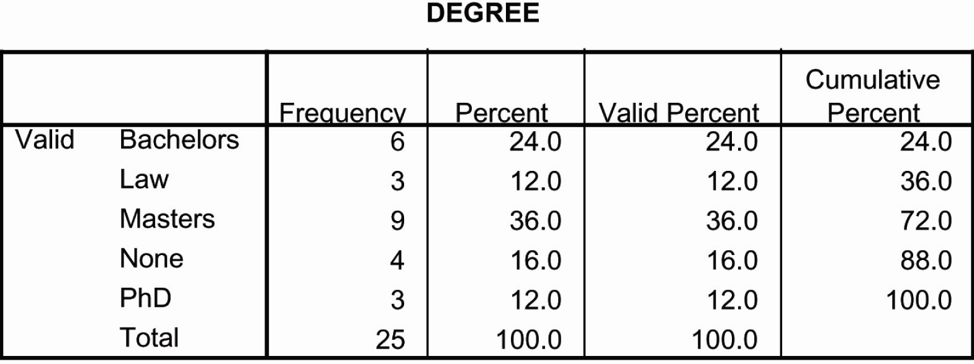
Example: using summary table
Class frequency
Class percentage

Slide 10
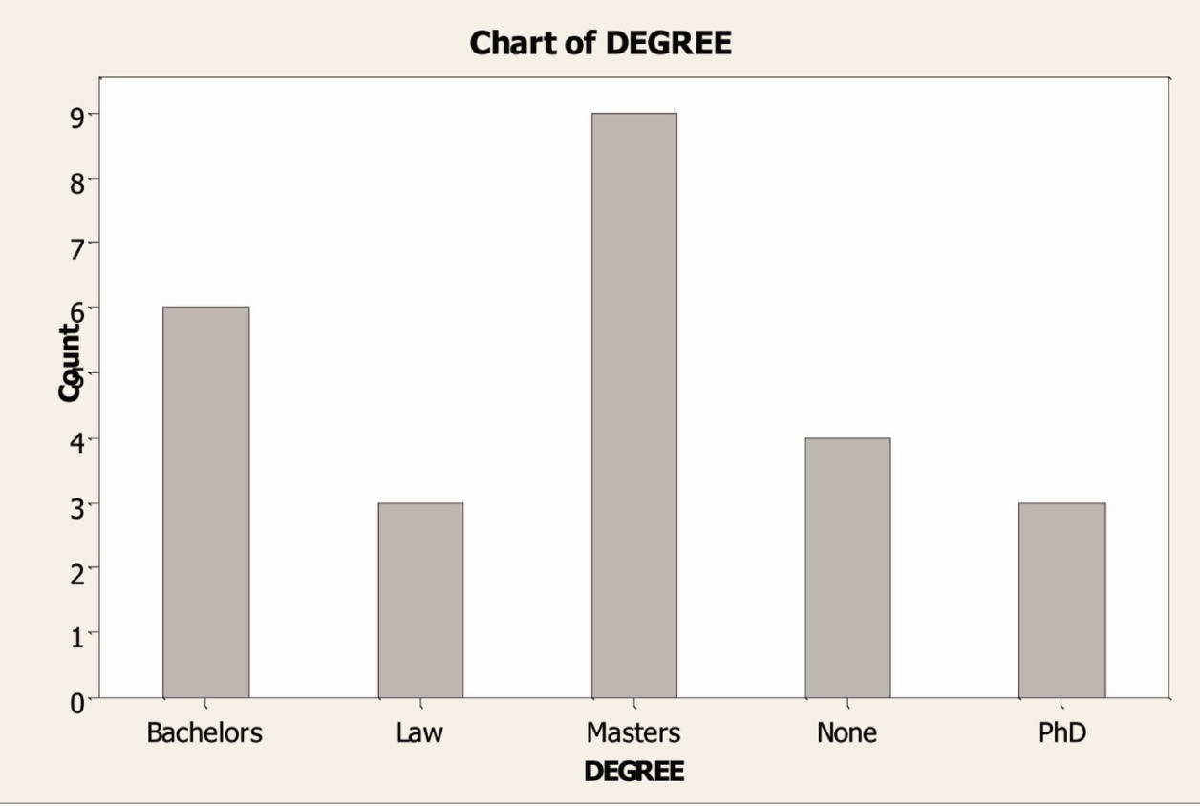
Example: using bar chart
Bar chart

Slide 11
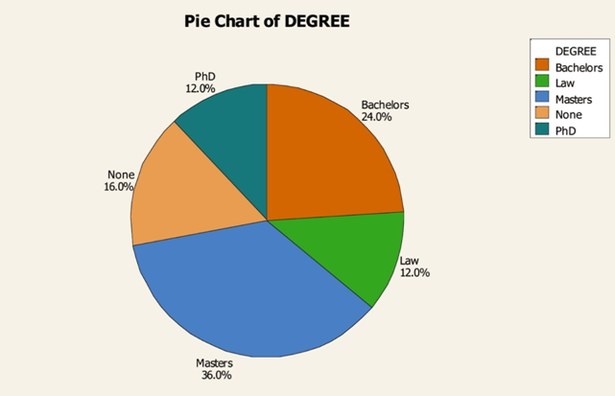
Example: using pie chart

Slide 12
Graphical methods for describing quantitative data
R&D intensity=R&D expenditure/Revenues

Slide 13
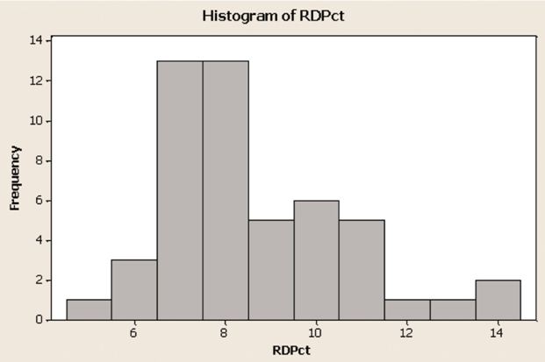
Histogram: a bar chart of data that have been grouped into a frequency distribution
histogram
7

Slide 14
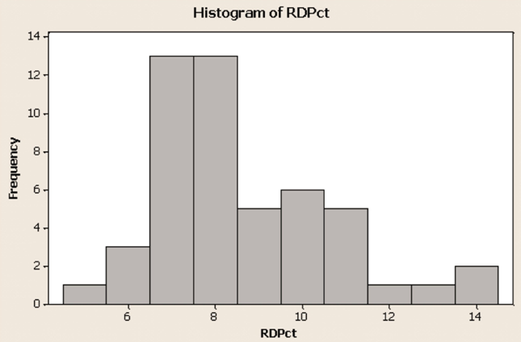
Example: frequency polygon

Slide 15
Example: cumulative frequency distribution
Cumulative frequency (either absolute frequency or relative frequency)
R&D spending percentage

Slide 16
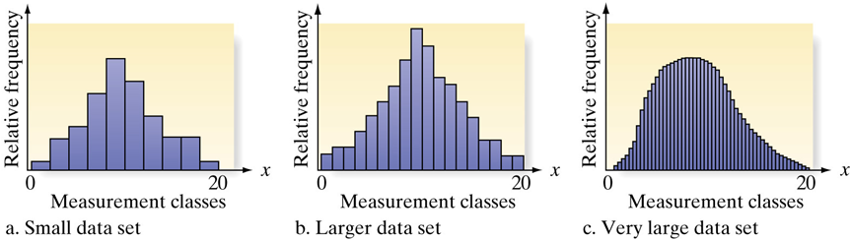
Graphical methods for describing quantitative data
Number of Observations in Data Set | Number of Classes
Less than 25 | 5-6
25-50 | 7-14
More than 50 | 15-20

Slide 17
Numerical methods
Central tendency
Dispersion
Symmetry (FYI: not our focus)

Slide 18
Numerical measures of central tendency
Central tendency
Tendency of data to center about certain numerical values (where the data are centered)
Three commonly used measures of
Central Tendency
Mean
Median
Mode

Slide 19
Mean
Arithmetic average of the elements of the data set
The sum of the observations divided by the number of observations
Sample mean denoted by
Population mean denoted by
Finite population

Slide 20
Cross-sectional mean
In cross-sectional data
Multiple objects recorded once in the data
Time-series mean
In time-series data
Same objects recorded multiple times in the data

Slide 21
Trimmed mean
5% trimmed mean
discard the lowest 2.5% and the largest 2.5% of values
Winsorized data
Winsorized at 95%
Set the bottom 2.5 percent of values equal to the 2.5th percentile value
Set the upper 2.5 percent of values equal to the 97.5 percentile value
2.5%
97.5%
2.5%
97.5%

Slide 22
Weighted mean
Weighted mean
The sum of the weights equals 1

Slide 23

Geometric mean
Geometric Mean
Where for $i=1,2,3…,n$

Slide 24
Geometric mean return formula

Slide 25
Example
Setting: no dividend payment
Initial invest $100
1st year end, $200 [return=(200-100)/100=100%]
2nd year end, $100 [return=(100-200)/200=-50%]
$100-$200-$100
Arithmetic mean of annual return
(100%-50%)/2=25%
Geometric mean of annual return
[(100%+100%)(100%-50%)]^{1/2}-1=0

Slide 26
When to use geometric mean?
A better measure for the past investment performance
Note: Divergence between arithmetic mean and geometric mean
Backward looking context (does not measure the variability)
Geometric Mean
Forward looking context (measure the variability)
Arithmetic Mean

Slide 27
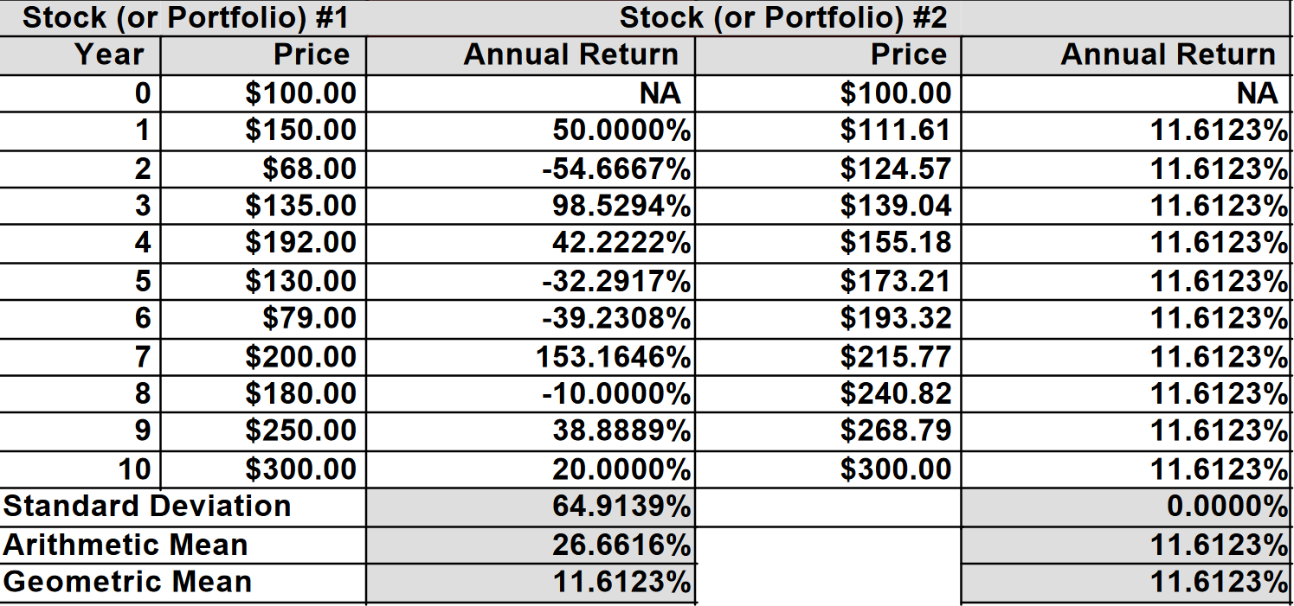
Geometric mean vs Arithmetic mean

Slide 28
Example
Mutual fund annual return

Slide 29
Median
Middle number when observations are arranged in ascending or descending order
Median denoted by m
Median is a single number!!!
When the number of observations is odd
m is the [(n+1)/2]^{th} observation
When the number of observations is even
m is arithmetic mean of the [n/2]^{th} and [n/2+1]^{th} observations

Slide 30
Median
If n is an odd number
If n is an even number
1
2
…
(n+1)/2
…
n-1
n
median
1
2
…
n/2
+
n/2+1
…
n-1
n
=
median
2

Slide 31
Mode
The most frequently occurring value in the data set
The value has the highest frequency
Data set can be multi-modal
Have more than one mode
Data displayed in a histogram will have a modal class
The class with the largest frequency

Slide 32
Mode (cont’d)
Variable with continuous distribution may not have a modal outcome
Group the data in to modal interval
The highest frequency
Modal class
7 8

Slide 33
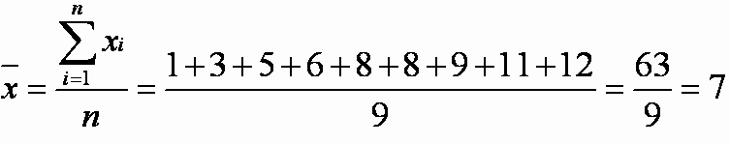
Example: numerical measure of central tendency
The Data set 1 3 5 6 8 8 9 11 12
Mean
Median or the 5th observation, 8
Mode 8, we observe 8 twice in the dataset

Slide 34
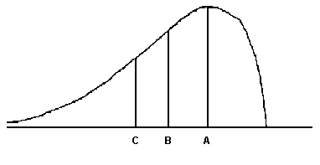
Numerical measures of central tendency
For the distribution drawn here, identify the mean, median, and mode.
A) A = mean, B = mode, C = median
B) A = mode, B = mean, C = median
C) A = mode, B = median, C = mean
D) A = median, B = mode, C = mean

Slide 35
Numerical measures of central tendency
For the distribution drawn here, identify the mean, median, and mode.
A) A = mean, B = mode, C = median
B) A = mode, B = mean, C = median
C) A = mode, B = median, C = mean
D) A = median, B = mode, C = mean

Slide 36
Other measures of location: Quantiles
Quartiles
Divide the distribution into quarters
Quintiles
Divide the distribution into fifths
Deciles
Divide the distribution into tenths
Percentile
Divide the distribution into hundredths

Slide 37
Measures of dispersion
Dispersion is the variability around the central tendency
Variability – the spread of the data across possible values
Three commonly used measures of Variability:
Range
Variance
Standard deviation

Slide 38
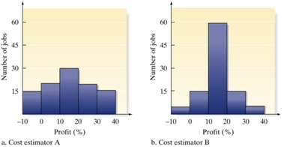
Range
The difference between the maximum and minimum values in a dataset
Largest measurement minus the smallest measurement
Loses sensitivity when data sets are large
These two distributions have the same range.
How much does the range tell you about the data variability?

Slide 39
Mean absolute deviation (MAD)
Arithmetic mean is 3.54
Mean absolute deviation

Slide 40
Population variance and standard deviation
Population variance

Slide 41
Sample variance and standard deviation
The sample variance (s²)
The sum of the squared deviations from the mean divided by (n-1)
Degrees of freedom: n-1
Expressed as units squared

Slide 42
Sample standard deviation
The positive square root of the sample variance
Expressed in the original unit of measurement

Slide 43
Parameter and statistic
Parameter
A descriptive measure for a population
Statistic
A descriptive measure for a sample

Slide 44
Numerical measures of variability
 | Sample | Population
Variance | s²
Standard deviation | s

Slide 45
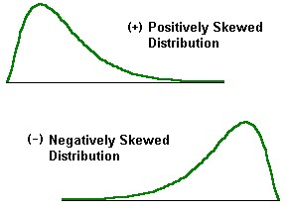
Symmetry and skewness
Skewness (sometimes referred as relative skewness)
A distribution is not symmetrical is called skewed
Positively skewed (skewed to the right)
Long tail on the right side
Negatively skewed (skewed to the left)
Long tail on the left side

Slide 46
Skewness
The sign indicates the direction of skewness
For large dataset
As a frame of reference, for a sample size of 100 or larger taken from a normal distribution, a skewness coefficient of +/-0.5 would be considered unusually.

Slide 47
Kurtosis
A statistical measure that indicate whether a distribution is more or less peaked than a normal distribution
A statistical measure used to describe the distribution of observed data around the mean
A distribution that is more peaked than normal is called leptokurtic
A distribution that is less peaked than normal is called platykurtic
A distribution that is identical to the normal distribution is called mesokurtic

Slide 48
Kurtosis (cont’d)
For normal distribution
Kurtosis is equal to 3
Excess kurtosis=(Kurtosis-3)
A normal of mesokurtic distribution has excess kurtosis equal to 0
A leptokurtic distribution has excess kurtosis greater than 0
More peaked than a normal distribution
A platykurtic distribution has excess kurtosis less than 0
Less peaked than a normal distribtution

Slide 49
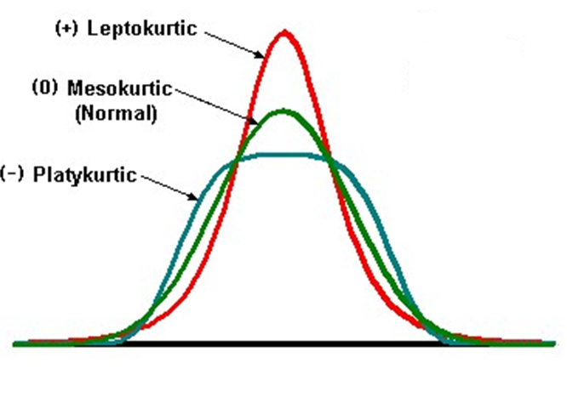
An example: Kurtosis

Slide 50
Chebyshev’s inequality
Russian mathematician Pafnuty Chebyshev
Inequality using standard deviation as a measure of dispersion
Definition
The proportion of the observations within k standard deviations of the arithmetic mean is at least

Slide 51
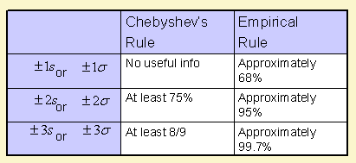
Interpreting the standard deviation
How many observations fit within + n standard deviations of the mean?

Slide 52
Numerical measures of relative standing
Descriptive measures of relationship of a measurement to the rest of the data
z-score
The distance between a measurement x and the mean, expressed in standard units
Use of standard units allows comparison across data sets
A standardized variable has
Mean 0
Standard deviation 1

Slide 53
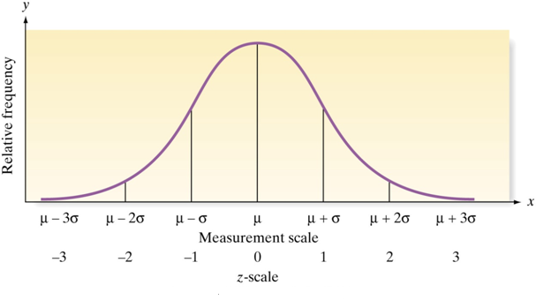
More on z-scores

Slide 54
Outliers
Outlier – a measurement that is unusually large or small relative to the data values being described
Causes
Invalid measurement
Misclassified measurement
A rare (chance) event
Method
z-scores
Scores of ±3 in mound-shaped distributions (±2 in highly skewed distributions) are considered outliers

Slide 55
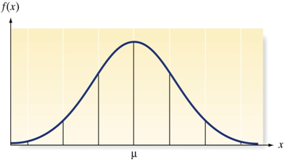
Normal distribution
A normal random variable has a probability distribution called a normal distribution
The Normal Distribution
1. Bell-shaped curve
2. Symmetrical about its mean μ
3. Mean, median, mode are equal
4. Spread determined by the value
of it’s standard deviation σ
5. Random variable has infinite range
Mean
Median
Mode

Slide 56
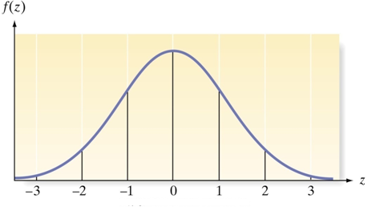
The standard normal distribution
Probabilities associated with values or ranges of a random variable correspond to areas under the normal curve
Calculating probabilities can be simplified by working with a Standard Normal Distribution
A Standard Normal Distribution
is a normal distribution
with μ =0 and σ =1
The standard normal random variable
is denoted by the symbol z

Slide 57
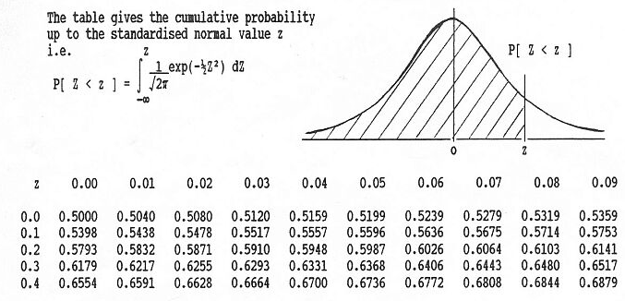
Standard normal distribution table Source: http://sweb.cz/business.statistics/normal01.jpg
Excel
=norm.s.dist(0.08,1)=0.5319

Slide 58
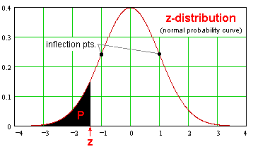
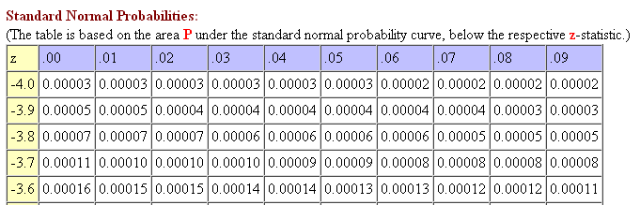
Standard normal distribution table
Source: http://math2.org/math/stat/distributions/z-dist.htm

Slide 59
Standard Normal Distribution
Example: P(z<0.67)
Excel: =norm.s.dist(0.67,1)=0.7486
Question: P(z>1.64)
?

Slide 60
Standard Normal Distribution
Example: P(z<0.67)
Excel: =norm.s.dist(0.67,1)=0.7486
Question: P(z>1.64)
P(z>1.64)=P(z<-1.64)
=norm.s.dist(-1.64,1)=0.0505

Slide 61
Application for the normal distribution 1
Steps for finding a probability corresponding to a normal random variable
Sketch the normal distribution, indicate mean, shaded area of interest
Convert to standard z values and add z values to the sketch
Use tables to calculate probabilities, making use of symmetry property where necessary

Slide 62
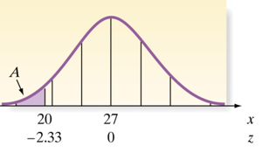
Example: making an inference
Question: How likely is an observation in area A (x<20), given an assumed normal distribution with mean of 27 and standard deviation of 3?
z value for (x=20) is -2.33
P(x<20) = P(z<-2.33) =0.0099
You could reasonably conclude that:
If the event happens, it is a rare event
The probability model may not be correct. Perhaps the assumption of a normal distribution is unwarranted or the mean of 27 is overestimated, or the std. dev. of 3 is underestimated, or combination of both
2.33

Slide 63
Application of the normal distribution 2
Safety-first rules (SFRatio)
Under the normality assumption
Standard deviation captures the variability both above and below mean
Benchmark (acceptable return level)
SFRatio=[E(Rp)-R_{L}]/σ_{p}
Benchmark
Sharpe ratio

Slide 64
How to apply SFRatio in investment decision ?
Question: if return below 3.75% is unacceptable, which portfolio should an investor choose?

Slide 65
Calculate each portfolio’s SFRatio: Choose the portfolio with the highest SFRatio
Allocation A: (25-3.75)/27=0.787937
Allocation B: (11-3.75)/8=0.90625
Allocation C: (14-3.75)/20=0.5125
Answer: B gives the highest SFRatio

Slide 66

Question: What is the probability that return on the safety-first optimal portfolio will be less than the acceptable level?
$$P(RB<3.75)$$
3.75
11

Slide 67
In terms of standard normal distribution
P(R_{B}<3.75)=P[z<(3.75-11)/8]=P(z<-0.90625)
=norm.s.dist(-0.90625,1)=0.1824
-0.90625
0
0.90625

